Slide 1
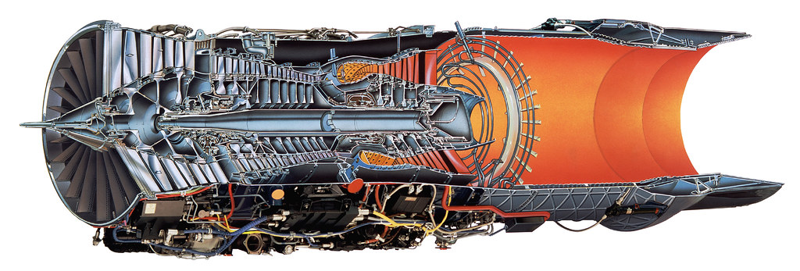
The first line of article title second line (font Garamond at minimum height 40 pt.)
Name Surname¹⁾, Name Surname ²⁾ In first line name and surname (font Garamond at minimum height 24 pt.)
¹⁾ Afiliation, email: mail@server.edu ²⁾ Afiliation, email: mail@server.edu In second line affiliation and email of the author(s) with hyperlinks
INTRODUCTION (font Segoe UI 32 pt.)
(font Garamond at minimum height 20 pt.) The introduction should include the aim and research hypotheses. If the paper is based on empirical research, the author should provide a brief description of the research methodology used (minimum font height 20 points)..., Mauris ut orci dapibus, sollicitudin metus id, facilisis magna. Praesent pellentesque consequat nibh. Ut egestas velit quis ante tincidunt, eget luctus orci tincidunt. Cras massa augue, facilisis sit amet mattis vel, mollis vel neque. Nam maximus laoreet erat, a sagittis risus auctor non. Interdum et malesuada fames ac ante ipsum primis in faucibus. Praesent at interdum felis. Pellentesque facilisis vulputate justo, in euismod turpis aliquet id. Nam ut nibh eros. Vivamus lacus orci, rhoncus quis sodales et. Donec interdum felis fringilla posuere pellentesque. Duis elementum blandit justo, eget tincidunt diam sollicitudin sed. Nulla hendrerit tempor nisi non feugiat. Curabitur a auctor nisl. Sed sagittis purus ac felis venenatis, at sagittis ante suscipit. Nulla lacinia eros odio, sit amet fringilla nisl porttitor sit amet. Nunc tempus, nunc a rutrum ullamcorper, lacus purus porttitor lacus, vitae ullamcorper erat erat quis nibh. Sed vitae diam sed quam malesuada gravida sed ac nisl. Fusce sed accumsan puru.
SELECTED TEST RESULTS (font Segoe UI 32 pt.)
(font Garamond at minimum height 20 pt.) The poster should contain only the most important information, presented in a compact and clear form. Mauris ut orci dapibus, sollicitudin metus id, facilisis magna. Praesent pellentesque consequat nibh. Ut egestas velit quis ante tincidunt, eget luctus orci tincidunt. Cras massa augue, facilisis sit amet mattis vel, mollis vel neque. Nam maximus laoreet erat, a sagittis risus auctor non. Interdum et malesuada fames ac ante ipsum primis in faucibus. Praesent at interdum felis pellentesqu.
Technical requirements for the poster
poster format: A1, i.e. 59.4 cm wide and 84.1 cm high, vertical orientation, color print, it is suggested to format the main text in two columns.
Figure 1. Results of measurement
Required elements of the scientific poster layout:
Title of the article in English (minimum font height 37 points). Names of authors and their affiliations (minimum font height 27 points). Introduction, which should include the aim and research hypotheses (minimum font height 20 points). If the paper is based on empirical research, the authors should provide a brief description of the research methodology used. Selected test results (minimum font height 20 points). Quantitative research results should be presented in the form of tables and graphs. Qualitative research results may include selected models, drawings, pictures and photos. Summary and / or conclusions (minimum font height 20 points), Summary and keywords in English (minimum font height 20 points). At the bottom of the poster there should be information about the conference for which the poster has been prepared (minimum font height 27 points).
Captions for the drawings in English (minimum font height 16 points). Mauris ut orci dapibus, sollicitudin metus id, facilisis magna. Praesent pellentesque consequat nibh. Ut egestas velit quis ante tincidunt, eget luctus orci tincidunt.
Table 1. Results of measurement
Header 1 | Header 2 | Header 3 | Header 4 | Header 5
1 | 12312.35 | First | - | horizontal
2 | 45656.44 | Second | yes | vertical
3 | 1241.22 | Third | - | vertical
4 | 436563.45 | Fourth | no | horizontal
Mauris ut orci dapibus, sollicitudin metus id, facilisis magna. Praesent pellentesque consequat nibh. Ut egestas velit quis ante tincidunt, eget luctus orci tincidunt. Cras massa augue, facilisis sit amet mattis vel, mollis vel neque. Nam maximus laoreet erat, a sagittis risus auctor non. Interdum et malesuada fames ac ante ipsum primis in faucibus. Praesent at interdum felis. Pellentesque facilisis vulputate justo, in euismod turpis aliquet id. Nam ut nif.
Mauris ut orci dapibus, sollicitudin metus id, facilisis magna. Praesent pellentesque consequat nibh. Ut egestas velit quis ante tincidunt, eget luctus orci tincidunt. Cras massa augue, facilisis sit amet mattis vel, mollis vel neque.
CONCLUSIONS (font Segoe UI 32 pt.)
Poster suitable for presentation should be uploaded in the abstract edit form by logging into your account on the website to SCEgeo account. The poster file name should be as follows: Surname_SCEGEO2020. Please include the data of only the first author of the paper.
Mauris ut orci dapibus, sollicitudin metus id, facilisis magna. Praesent pellentesque consequat nibh. Ut egestas velit quis ante tincidunt, eget luctus orci tincidunt. Cras massa augue, facilisis sit amet mattis vel, mollis vel neque. Nam maximus laoreet erat, a sagittis risus auctor non. Interdum et malesuada fames ac ante ipsum primis in faucibus. Praesent at interdum felis. Pellentesque facilisis vulputate justo, in euismod turpis aliquet id. Nam ut nibh eros. Donec interdum felis fringilla posuere pellentesque. Duis elementum blandit justo, eget tincidunt diam sollicitudin sed. Nulla hendrerit tempor nisi non feugiat. Curabitur a auctor nisl
Summary: This is summary in English. (font Garamond at minimum height 20 pt.) Mauris ut orci dapibus, sollicitudin metus id, facilisis magna. Praesent pellentesque consequat nibh. Ut egestas velit quis ante tincidunt, eget luctus orci tincidunt. Cras massa augue, facilisis sit amet mattis vel, mollis vel neque. Nam maximus laoreet erat, a sagittis risus auctor non. Interdum et malesuada fames ac ante ipsum primis in faucibus. Praesent at interdum felis. Pellentesque facilisis vulputate justo, in euismod turpis aliquet id. Nam ut nibh eros. Vivamus lacus orci, rhoncus quis sodales et. Donec interdum felis fringilla posuere pellentesque. Duis elementum blandit justo, eget tincidunt diam sollicitudin sed. Nulla hendrerit tempor nisi non feugiat. Curabitur a auctor nisl. Sed sagittis purus ac felis venenatis, at sagittis ante suscipit. Nulla lacinia eros odio, sit amet fringilla nisl porttitor sit amet. Nunc tempus, nunc a rutrum ullamcorper, lacus purus porttitor lacus, vitae ullamcorper erat erat quis nibh. Sed vitae diam sed quam malesuada gravida sed ac nisl. Fusce sed accumsan purus. Donec interdum felis fringilla posuere pellentesque. Duis elementum blandit justo, eget tincidunt diam sollicitudin sed. Nulla hendrerit tempor nisi non feugiat. Curabitur a auctor nisl. Sed sagittis purus felis venenatis, at sagittis.
Keywords: key word 1, key word 2, key word 3, key word 4, key word 5.

